Slide 1

Group 5
Pratyush Kumar Pandey, Ashton Lim, Heather Chew, Gao Sitian

Slide 2
Problem Formulation
Statement: Are review ratings of the listings reflective of its’ features?
Aim: Create the best model to predict ratings of the listings and find the features that truly reflect the ratings
Response variables: 1) review_scores_rating - provided in the dataset 2) analyser_review_rating - derived using sentiment analysis on texts in reviews

Slide 3
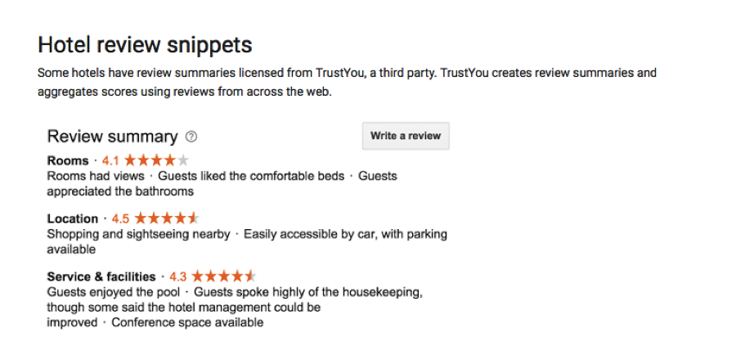
Practical Motivation
Notes:
The problem we’ve came out with is are reviews reflective of the features of the listings?

Slide 4
Data Cleaning
Removed: None, NaN and Listings with number of review < 30 Unwanted chars such as “$” and “%” using Regex Unnecessary columns (URLs, date scraped, etc)
One Hot Encoding to convert categorical type to numeric type for use in the ML algorithms.
Obtaining amenities score (number of amenities in a listing)
Added summary tags for all the listing(covered later)

Slide 5
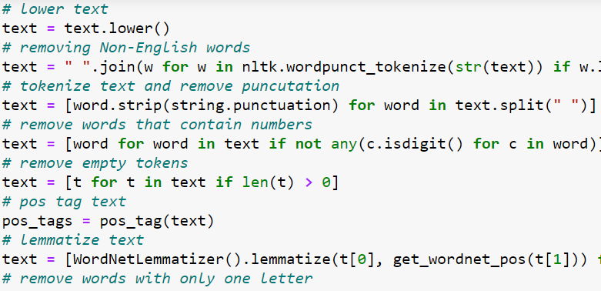
Data Cleaning
Text data cleaning for sentiment analysis - lemmatizing and removing special characters from text.

Slide 6
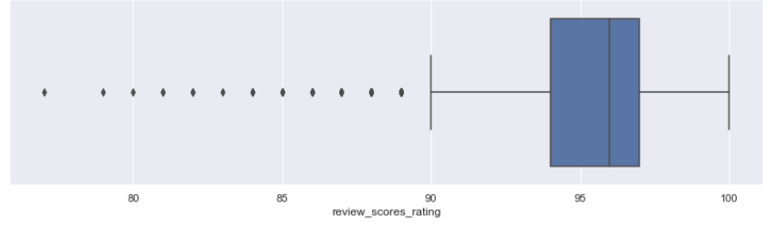
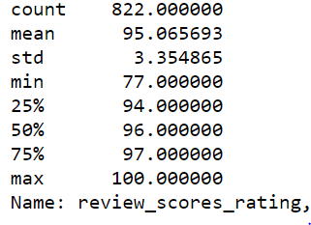
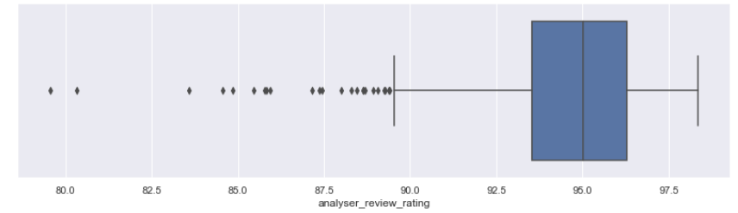
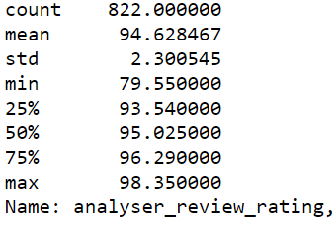
Exploratory Analysis (Univariate)
Exploring review_scores_rating
Exploring analyser_review_rating
Notes:
TALK BRIEF AND CONCISE
moving on to exploratory analysis
distribution of review scores rating is very skewed
overwhelming majority of ratings is between 90 to 100
low standard deviation
most of the outliers are in 80 - 90 range
The distribution of two are very similar

Slide 7
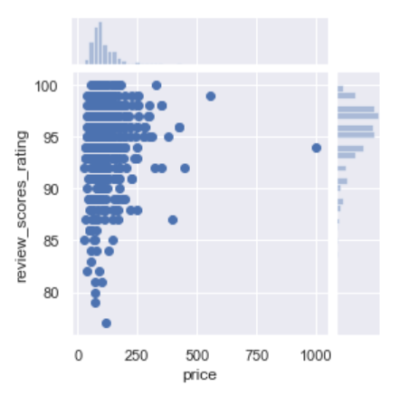
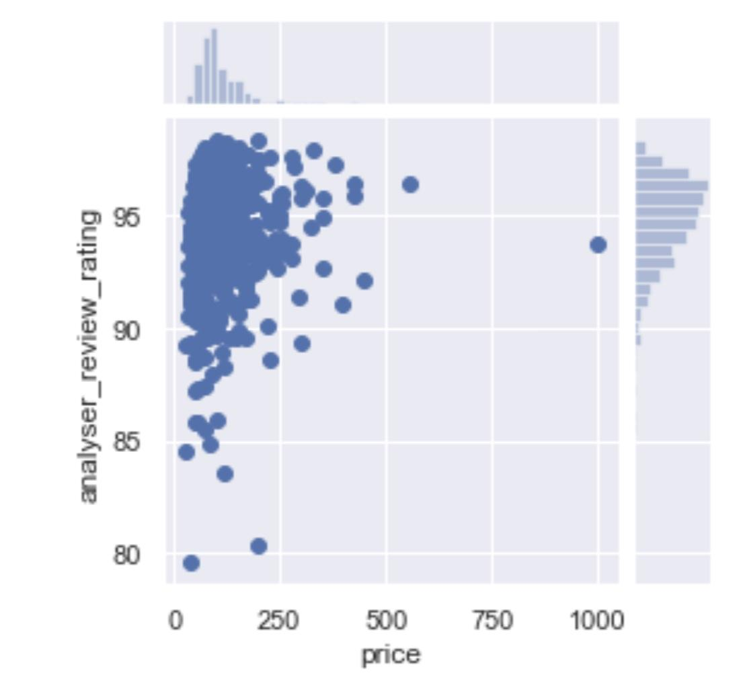
Exploratory Analysis (Multi-variate)
Notes:
we also did some jointplots between both rating scores
see that Correlation is low and points are clustered for price

Slide 8
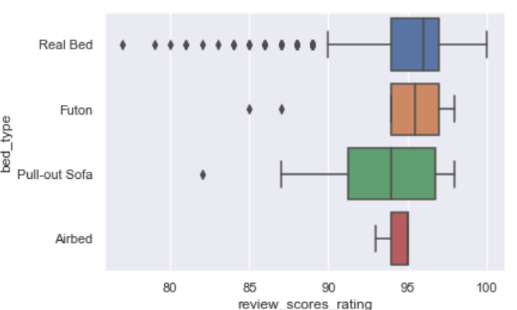
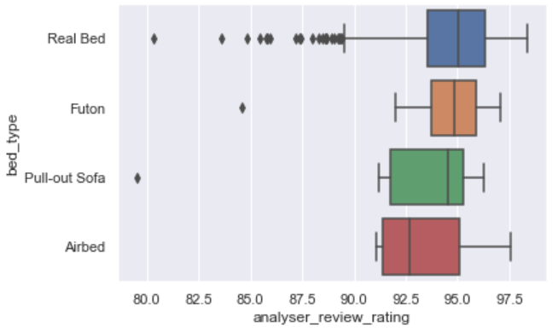
Exploratory Analysis (Multi-variate)
Notes:
Moving on to combined boxplot between review scores and bed types
Here we see that real beds have a lot more outliers, but that is because most of the listings have real beds, hence the number of outliers
There is a lot of overlap between the boxes, so its not very helpful in categorising review ratings
We can observe some differences in the mean, but is very slight and hence not helpful as full
Moving on to pratyush who will talk about machine learning

Slide 9
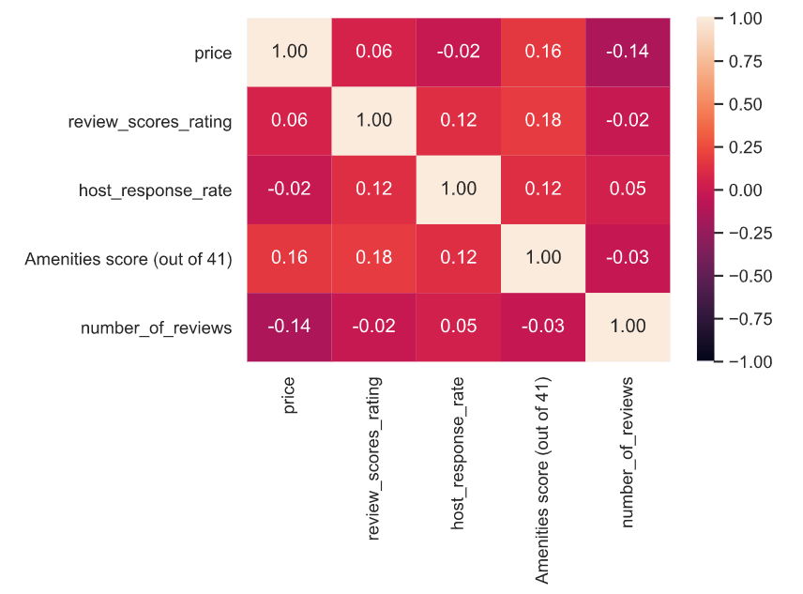
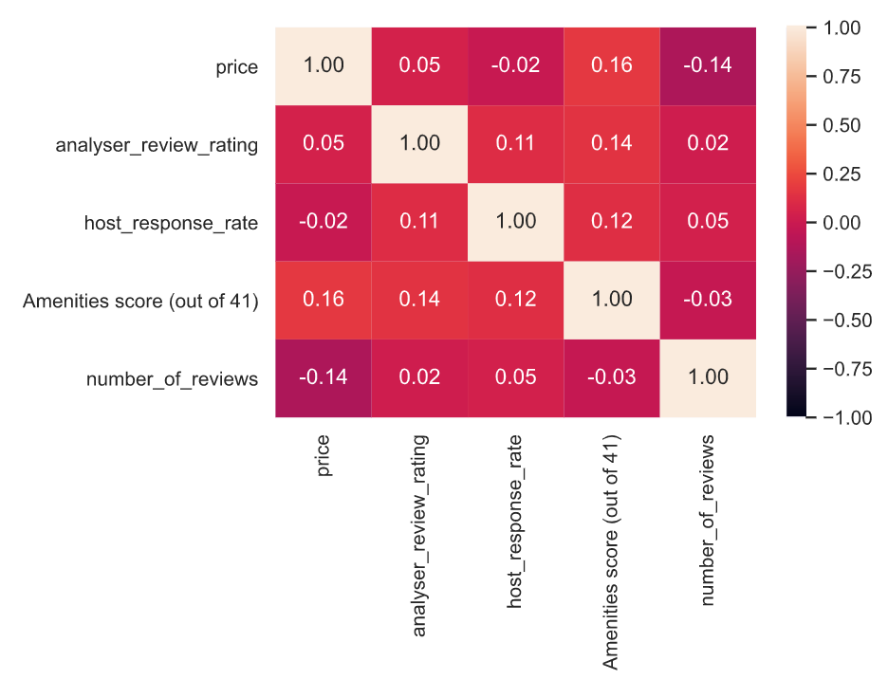
Exploratory Analysis (Multi-variate)
Notes:
Compared both review scores with listing features
from this heatmap we can see that correlation is very low between features of listing and both review ratings

Slide 10
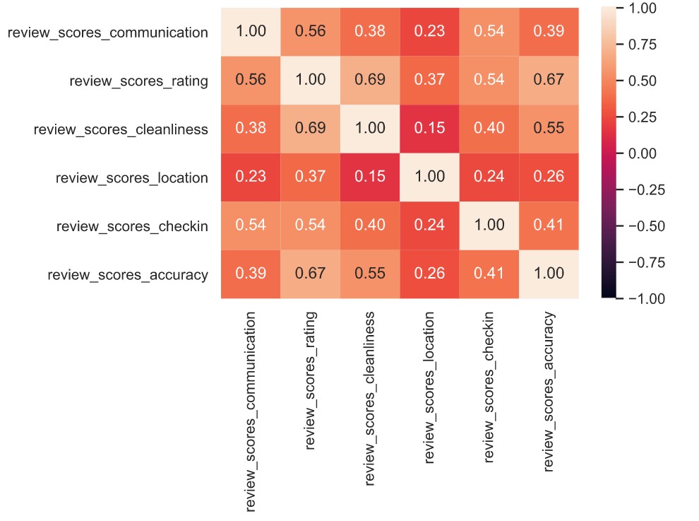
Exploratory Analysis (Multi-variate)

Slide 11
Machine Learning for Model 1
The data for model 1: Response variables: review_scores_rating, analyser_review_rating
Predictors: Listings’ features like amenities, bedrooms, bathroom, property_type etc.
Algorithms: Linear Regression, Classification

Slide 12
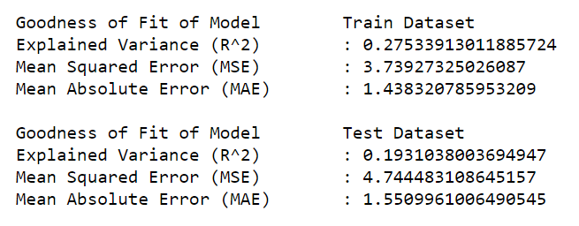
Regression (Library: LinearRegression)
Results for analyser_review_rating

Slide 13
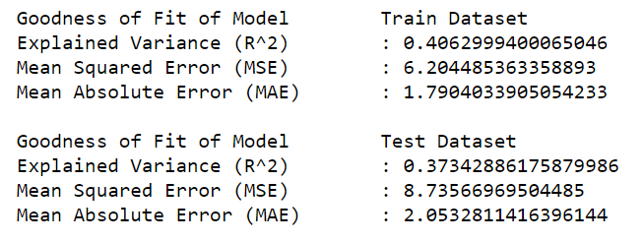
Regression (Library: LinearRegression)
Results for review_scores_rating

Slide 14
Classification
The response variables are numeric type so to make the classification model we made the classes using formula : Class = ⌊x ⁄ 10⌋
Where x is the response variable and ⌊ ⌋ represents the floor function.
Libraries used: Decision Tree Regressor and Logistic regression

Slide 15
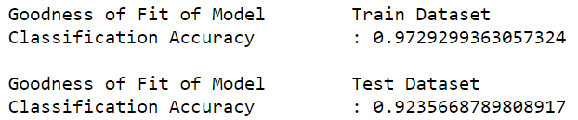
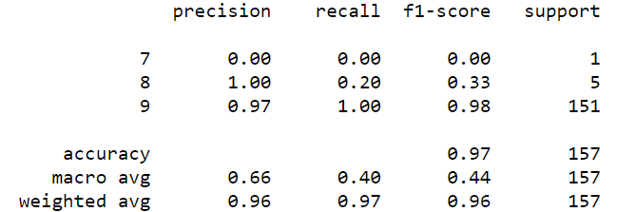
Classification
Decision Tree:
Logistic Regression:
Results with analyser_review_rating

Slide 16
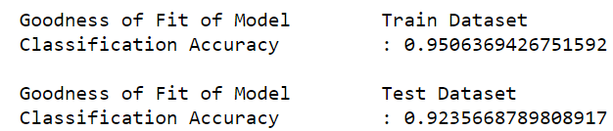
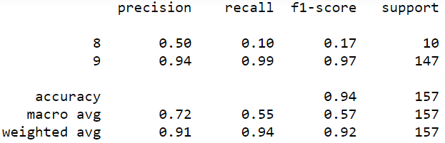
Classification
Decision Tree:
Logistic Regression:
Results with review_scores_rating

Slide 17
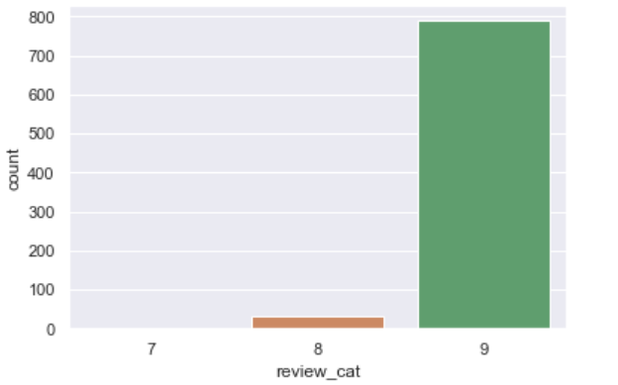

Classification
But ... the model is highly biased which is evident from f1-score and classification matrix:
High bias in classification for analyser_review_rating

Slide 18
Inferences from model 1
Regression model gives a good estimation in terms of mean square error and mean absolute error.
However, the model fails when error is compared with the variance in data.
Classification model yields very good results due to the highly biased nature of the data.

Slide 19
Machine Learning for Model 2
The data for model 2: Response variables: review_scores_rating, analyser_review_rating
Predictors: features based on user experience like communication, location, cleanliness etc.
Algorithms: Linear Regression, Classification, Anomaly Detection

Slide 20
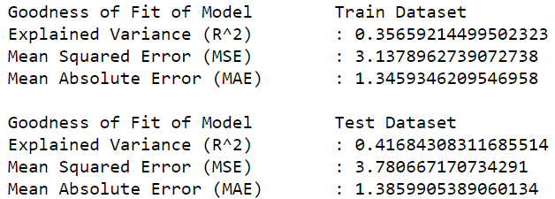
Regression (Library: LinearRegression)
Results with analyser_review_rating
Model 1 (previous)
Model 2
(new)
Notes:
Next, Results with analyser review rating
The left image shows the result for model 1 where the R squared for test is 0.19
The right image shows the result for model 2 where the R squared for test increases to 0.41
We see a similar trend in train dataset

Slide 21
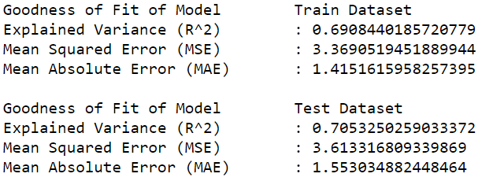
Regression (Library: LinearRegression)
Results with review_scores_rating
Model 1 (previous)
Model 2
(new)
Notes:
Next, Results with review scores rating
The left image shows the result for model 1 where the R squared for test is 0.37
The right image shows the result for model 2 where the R squared for test increases to 0.70
Even the MSE shows the downward trend from 8.73 to 3.61 in test
We see a similar trend in train dataset as well

Slide 22
Regression (Library: Random Forest)
Results of review_scores_rating
Notes:
These are the results we got with a different regression library but we choose Linear Regression because this model has widely different R squared values for train and test.

Slide 23
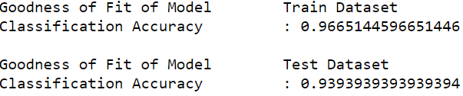
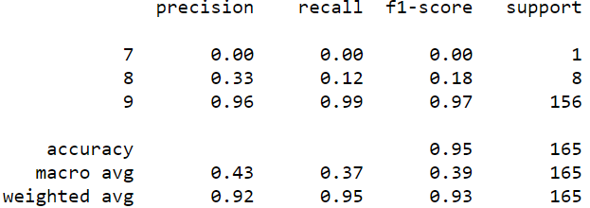
Classification
Decision Tree:
Logistic Regression:
Results with analyser_review_rating

Slide 24
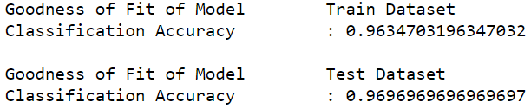
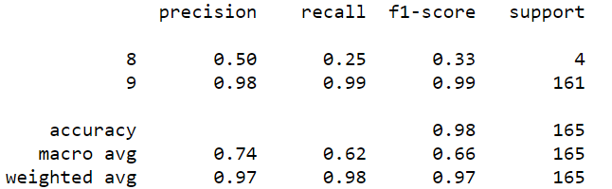
Classification
Decision Tree:
Logistic Regression:
Results with review_scores_rating

Slide 25
Classification
Though the data is highly biased for classification, the accuracy increased by 4% for review_scores_rating, assuming the best classification library for the 2 models.
Even the f1-score showed an upward trend when compared to the results of model 1.

Slide 26
Anomaly Detection
To further the analysis on model 2,
Multivariate anomaly detection was performed on the features used in model 2.
The aim was to check how the labelled anomalies would be distributed for review_scores_rating
Notes:
Thank you heather, so we also did multivariate anomaly detection on predictors used in model 2 to check the distribution of anomalies for review_score_rating

Slide 27
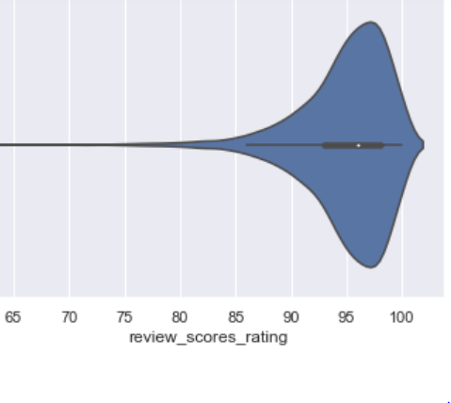
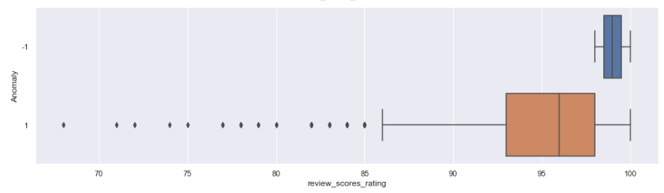
Anomaly Detection
The anomalies in the features help label the top boundary
points in review_scores_ratings.
anomalies
Notes:
here, the left boxplot shows the distribution of blue anomalies and orange not anomalies
And the right diagram show the distribution of review score rating
we can see that the anomalies lie between 98 to 100 rating score range and help to label the top boundary points in review_scores_rating

Slide 28
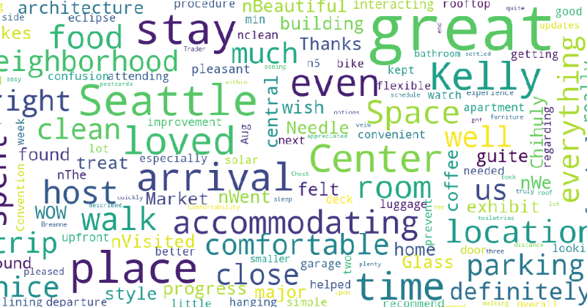
Analytic visualization
In an attempt to find a better model, we further analysed the data using Plotly and word Cloud.
Notes:
in addition, we also created a word cloud for the written reviews
In this picture u can see the most often used words in the positive reviews, like for example clean comfortable accommodating
from here we can infer that the experience of the user is more important in influencing them to make a good review

Slide 29
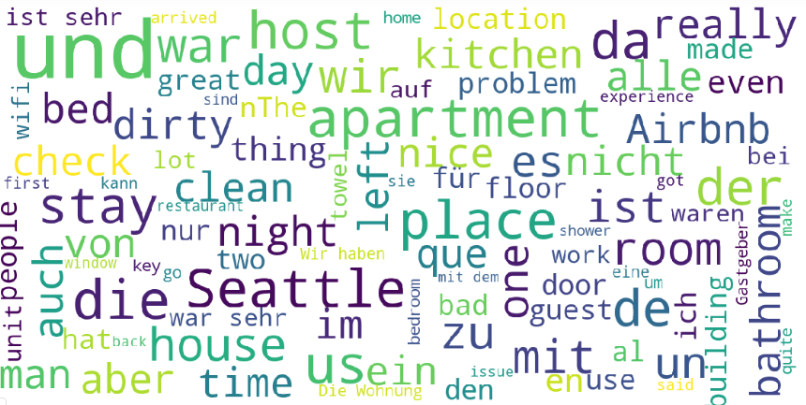
Analytic visualization (word Cloud)

Slide 30
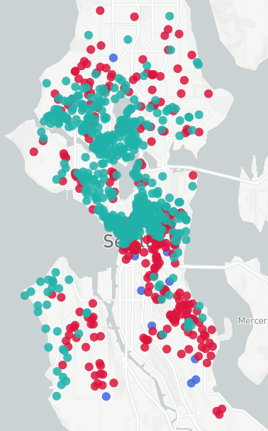
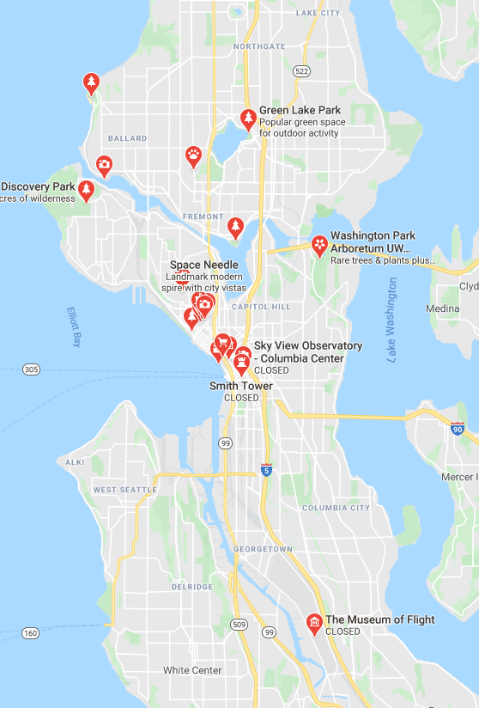

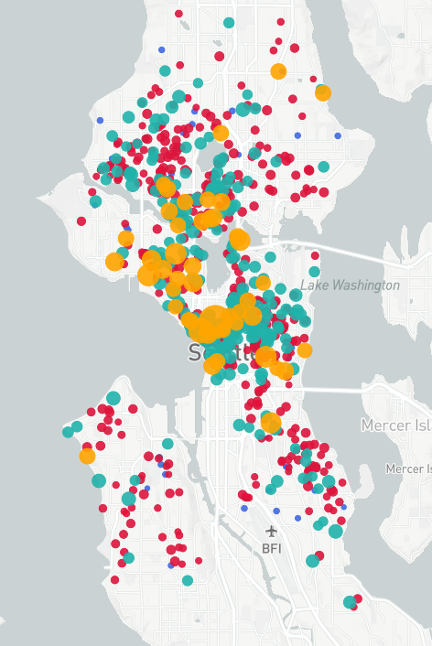
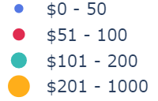
Analytic visualization (Plotly maps)
Location rating of listings
The map visuals show the distribution of review_location on the map of Seattle.
Notes:
we also did plotly map visualisations to see which are the areas that people like
from the map on the right we can see that areas labelled in turquoise, areas with beaches and waterfront views or recreational activities tend to be more highly rated
And these also tends to overlap with the highly priced ratings, which are labelled in yellow on the map on the left

Slide 31
Conclusions
1.The second model is a better reflection of review ratings of the listings.
2. The features of the listings are not a very good reflection of the review ratings.
3.It was difficult to make good regression/classification models due to skewness of review score dataset.
4. Optimize review scores for hosts.
Notes:
in conclusion, Our second model is much better at predicting review ratings
and the amenities and features of the listing does not predict review scores well
We faced some challenges due to the skewness of the review scores rating and analyser review rating datasets
Still, what we found can help owners improve upon their listings and get better reviews
This is useful for listers to know how they might best improve upon their review scores.

Slide 32
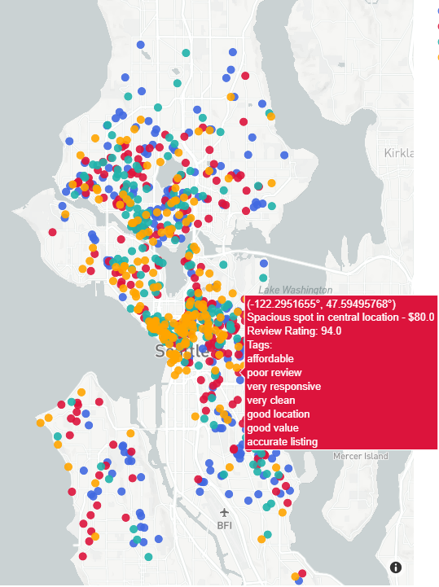
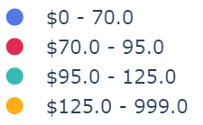
Improving Search Experience
Added summary tags for each listing.
E.g. cleanliness is mostly rated at a 9 or 10. Users who are not familiar with the site might believe 9 is a good rating when it is actually below average.
Notes:
We also realised that it can be difficult for users to gauge ratings without context of the whole data set
for example, cleanliness is mostly rated at a 9 or 10. Users who are not familiar with the site might believe 9 is a good rating when actually the review score rating is below average.
So what we recommend is that instead of displaying raw numerical ratings we use a descriptive tag system like the one in the red box that uses words like poor review, very responsive and very clean so users can understand how the ratings they see compare to the average.
Not always easy to understand if listings are good without context and looking at all the data

Slide 33
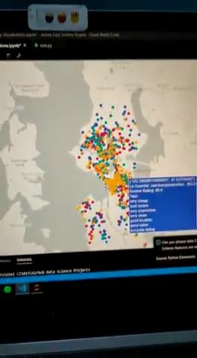
Search experience Demo

Slide 34
Learning Points
Individual Contributions
Natural Language Processing and Sentiment Analysis.
Text Data Cleaning and Normalization.
Plotly and word cloud visualization.
Logistic regression and importance of f1-score.
Ashton: Data Visualization, Regression models & Data Preparation
Sitian: Exploratory Analysis (Multi-variate) & Data Preparation
Heather: Classification Models & Exploratory Analysis(Uni-variate)
Pratyush: Natural Language Processing(Sentiment Analysis), Text Data Analysis & Anomaly Detection in the final model
Notes:
Learning points, through this project we had the opportunity to make use of natural language processing, sentiment analysis, word cloud visualisation, logistic regression, and new ways of data cleaning
for our individual contributions, ashton did the regression models and plotly visualisation
i did exploratory analysis and data preparation
heather did the classification models
and pratyush handled the natural language processing and anomaly detection

Slide 35
Thank you!
Notes:
thank you for listening

